Slide 1
Analyzing Bias in Good Mythical Morning
Benjamin Hill

Slide 2
On the YouTube channel, Good Mythical Morning, Rhett and Link have made videos in which they try and rate various foods. Sometimes Rhett expresses that Link’s scores are surprising to him, But Link always claims to take the act of judging very seriously. In this exploration we will determine whether Link’s scores are significantly different from Rhett’s.

Slide 3
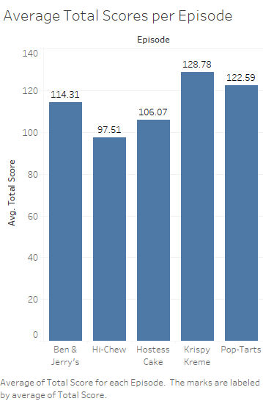
The average total scores (both judges’ scores added together) for each episode are shown in the chart. It seems that, overall, they enjoyed Krispy Kreme donuts the most and Hi-Chews the least, on average. It seems their average scores are decently consistent across the episodes.

Slide 4
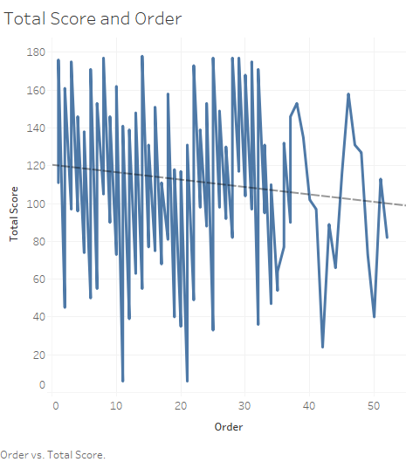
Does the order of appearance of foods in an episode affect the score given? There seems to be a slight negative correlation between total score and the order in which the foods appear; however, the r-squared value of the trendline is very low (0.016), which shows that the trend is not very strong. Therefore, I believe the total score of a food is not significantly affected by its order of appearance.
The chaotic tendency of the graph smooths out noticeably after about 35 – this is due to there only being 35 or fewer flavors tested in four of the five episodes, so the rest are from a single episode.

Slide 5
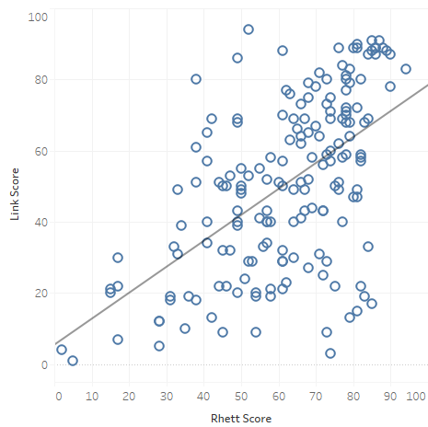
Relationship Between Scores
There seems to be a positive correlation between the scores of Rhett and Link, such that whenever Rhett gives a higher score, Link is also more likely to give a higher score. However, once again, the trendline’s r-squared value is decently low (0.31), so the correlation is tenuous. I conclude that there is no reliable correlation between the scores they each give.

